Slide 1
Hidden Surface Removal
CS 460: COMPUTER GRAPHICS

Slide 2
Lecture Outline
Introduction to Hidden Surface Removal
Ray Casting
Z Buffer Method
BSP (Binary Space Partition)
Back face Culling
Hidden Surface Removal in OGL

Slide 3
Introduction
Not every part of every 3D object is visible to a particular viewer. We need an algorithm to determine what parts of each object should be drawn.
Known as “hidden surface removal/elimination” or “visible surface determination”.
Hidden surface removal algorithm can be classified in three major ways:
  Object space vs. image space
  Object order vs. image order
  Sort first vs. sort last
  Still an active research area ……
This is very important as our 3D models get more and more complex
Where would we use a hidden surface algorithm?

Slide 4
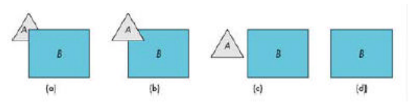
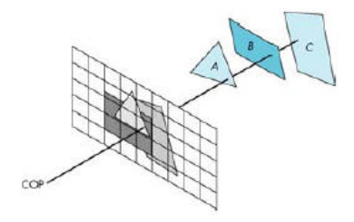
Detect Visible Surfaces
Object-space
- Comparison within real 3D scene
- Works best for scenes that contain few polygons
Image-space
- Decide on visibility at each pixel position

Slide 5
Detect Visible Surfaces
Image Space Algorithms
- Complexity = O(pixels * objects)
- e.g. 1286*1024 pixels and 1 million polygons
- Complexity = O(1.3 * 10¹²)
Object Space Algorithms
- Worst case might have to compare n objects with n-1 objects
- Complexity = O(n²)
- e.g. 1 million polygons,
Complexity = O(10¹²)

Slide 6
Object Order vs. Image Order
Object order
  Consider each object only once - draw its pixels and move on to the next object
  Might draw the same pixel multiple times
  E.g. Z-buffer and BSP
Image order
  Consider each pixel only once - draw part of an object and move on to the next pixel
  Might compute relationships between objects multiple times
  E.g. Ray Casting

Slide 7

Sort First vs. Sort Last
Sort first
  Find some depth-based ordering of the objects relative to the camera, then draw from back to front, e.g. Painter’s algorithm (binary space partitioning)
Sort last
  Sort implicitly as more information becomes available, e.g. Z-buffer

Slide 8
Important Algorithms
Ray casting
Z-buffer
Binary space partitioning
Back face culling

Slide 9
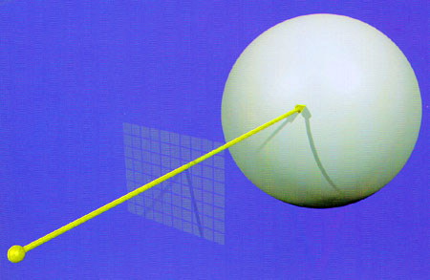
1. Ray Casting
Partition the projection plane (PP) into pixels to match screen resolution
  For each pixel p_{i}, construct ray (projector) from COP through PP at that pixel and into scene
  Intersect the ray with every object in the scene, color the pixel according to the object with the closest intersection

Slide 10
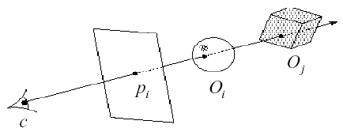
Ray Casting Implementation
Parameterize the ray:
R(t) = (1-t)c + tp_{i}
  If a ray intersects some object O_{i}, get parameter t such that first intersection with O_{i} occurs at R(t_{i})
  Which object owns the pixel?
We will study ray-object intersections in more detail later (essential in ray tracing).

Slide 11
Ray Casting: Analysis
Categorization (refer to the basic Ray Casting):
Easy to implement? Y
Hardware implementation? N (not natively)
Memory intensive? Y/N (scene-dependent, no. of recursions)
Pre-processing required? N
Online? N
Handles transparency? Y
Handles refraction? Y
Polygon-based? N (can be implicit surface)
Extra work for moving objects? N
Extra work for moving viewer? N
Efficient shading? N (in later lecture)

Slide 12
Z-buffer
Idea: along with a pixel’s red, green and blue values, also store its depth
  An additional channel in memory, like alpha
  Called the depth buffer or Z-buffer (2D array of depth values)
When the time comes to draw a pixel, compare its depth with the depth of what’s already in the Z buffer. Replace only if it’s closer
  Very widely used in hardware from 90’, e.g. SGI, NVidia, ATI, etc.
History
  Originally described as “brute-force image space algorithm”
  Written off as impractical algorithm for huge memories
  (in 1974 by Catmull)
  Today, done easily in hardware

Slide 13
Z-buffer Implementation
# Clear depth and frame (RGBA) buffer
For each pixel pi
Z-buffer [ pi ] = FAR
Frame-buffer [ pi ] = BACKGROUND_COLOR
End
# Render each polygon with Z buffer
For each polygon P
For each pixel pi in rasterized P
compute depth z and shade s of P at pi
if z < Z-buffer [ pi ]
Z-buffer [ pi ] = z
Frame-buffer [ pi ] = s
End
End
End

Slide 14
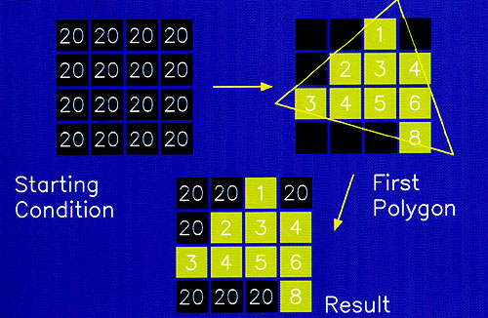
Z-Buffer Algorithm

Slide 15
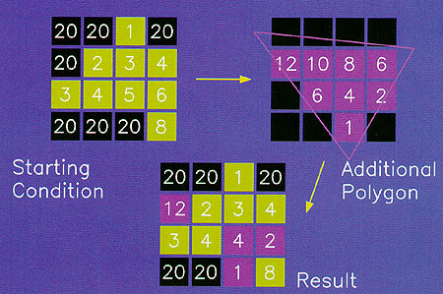
Z-Buffer Algorithm

Slide 16
Z Buffer: Analysis
Categorization:
Easy to implement? Y
Hardware implementation? Y
Memory intensive? Y (need z buffer)
Pre-processing required? N
Online? Y
Handles transparency? N
Handles refraction? N
Polygon-based? Y
Extra work for moving objects? N
Extra work for moving viewer? N
Efficient shading? Y (in later lecture)

Slide 17
Binary Space Partitioning
Goal: build a tree that captures some relative depth information between objects. Use it to draw objects in the right order.
  Tree doesn’t depend on camera position, so we can change viewpoint and redraw quickly
  Called the binary space partitioning tree, or BSP tree
Key observation: The polygons in the scene are painted in the correct order if for each polygon P,
  Polygons at the back of P are painted first
  P is painted next
  Polygons in front of P are painted last
  This is called Painter’s Algorithm

Slide 18
Rendering a BSP tree
Given a polygon p
Two lists of polygons:
  those that are behind(p) : B # Back
  those that are in-front(p) : F # Front
If eye is in F, right display order (back-to-front order) is B, p, F
Otherwise it is F, p, B

Slide 19
Constructing a BSP Tree
BSPtree makeBSP( L: list of polygons ) {
if L is empty {
return the empty tree
}
Choose a polygon P from L to serve as root
Split all polygons in L according to P
return new TreeNode(
P,
makeBSP( polygons on negative side of P ),
makeBSP( polygons on positive side of P ))
}
Splitting polygons is expensive! It helps to choose P
wisely at each step.
Example: choose five candidates, keep the one that
splits the fewest polygons

Slide 20
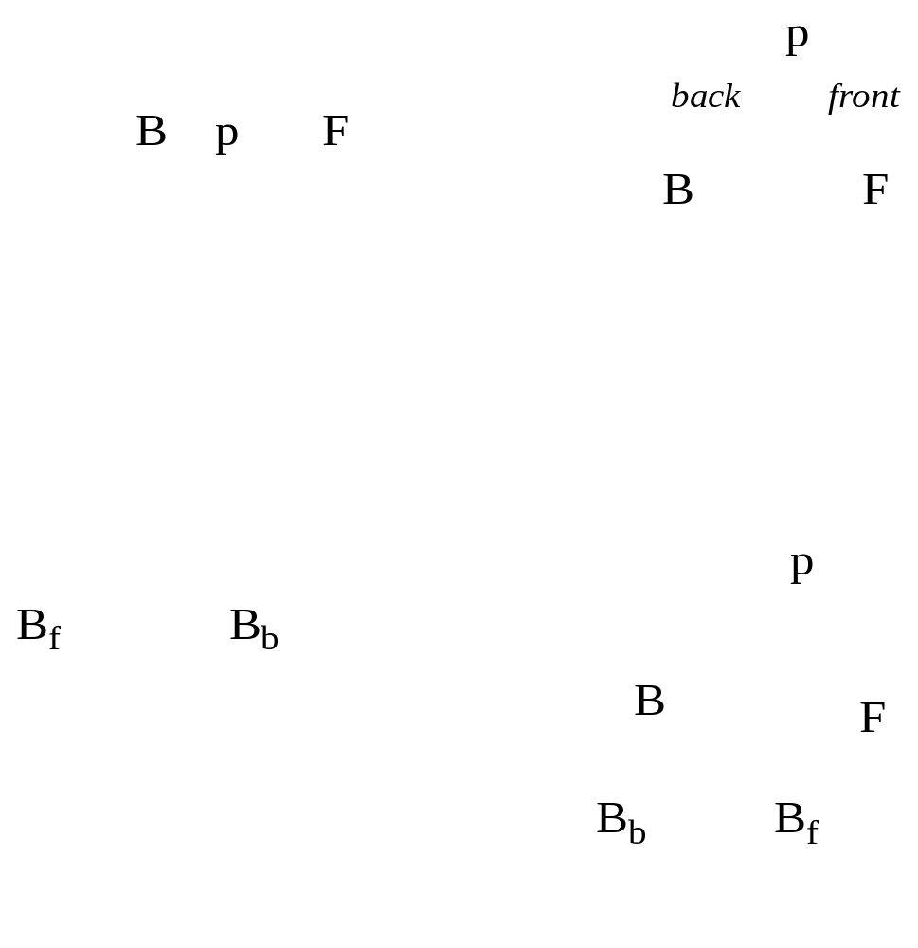
Eg.1 Constructing a BSP tree
Step 1: three polygons
Step 2: two more polygons B_{b} and B_{f}
B

Slide 21
Eg.2: Constructing a BSP tree
5
3
5a
2
5a
5b
3
Step1: pick 3 as the root
1
1, 2, 5a
4, 5b
4
Note: Subdivide 5
(an object being cut through) into 5a,5b
3
Step2: pick 2 for one branch
2
5a
5b
3
2
1
4, 5b
4
1
5a
Step3: pick 4 for the
other branch
3
2
5a
5b
3
2
4
1
4
1
5a
5b

Slide 22
Rendering a BSP Tree
showBSP( v: Viewer, T: BSPtree ) {
if T is empty then return
P := root of T
if viewer is in front of P {
showBSP( back subtree of T )
draw P
showBSP( front subtree of T )
} else {
showBSP( front subtree of T )
draw P
showBSP( back subtree of T )
}
}

Slide 23
BSP Tree: Analysis
Categorization:
Easy to implement? N (but source from web)
Hardware implementation? N
Memory intensive? Y/N (scene dependent)
Pre-processing required? Y
Online? N
Handles transparency? Y
Handles refraction? N
Polygon-based? Y
Extra work for moving objects? Y
Extra work for moving viewer? N
Efficient shading? Y

Slide 24
Back Face Culling
Used in conjunction with polygon-based algorithms
  Often, we don’t want to draw polygons that face away from the viewer. So test for this and eliminate (cull) back-facing polygons before starting to draw
  Can be used with ray casting and Z-Buffer algorithms
How can we test for this?

Slide 25
Back Face Culling
What is a normal vector? (see the lecture notes in 2D/3D Math.)
It is a vector pointing in an orthogonal direction of a plane.
A polygon is front facing when θ, the angle between the viewer and the normal to the polygon, lies between -90º to + 90º or cos θ ≥ 0
normal vector

Slide 26
Back Face Culling
(right hand rule)
Use dot product to test for visibility.
Visibility test: N_{p} . V > 0
where N_{p} is the polygon normal
V is the line of sight (viewing) vector
How to calculate polygon normal?
A polygon is front facing when θ, the angle between the viewer and the normal to the polygon, lies between -90º to + 90º or cos θ≥0
All vertices of polygons must be listed in the same order (either clockwise or anticlockwise)

Slide 27
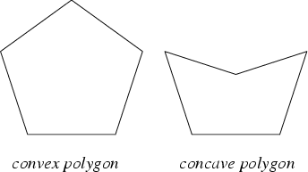
Back Face Culling
Eye space is the most convenient space in which to ‘cull’ polygon
Remove all polygons that face away from the viewer
For a scene that consists of only a single closed convex object, it solves the hidden surface problem completely.
Does not work for scene with multiple objects (occlusion not accounted for)
Cannot remove all unnecessary polygons of a concave object (occlusion not accounted for)
In most cases, back face culling serves as a preprocessing step to reduce invisible polygons for Z-buffer or ray casting algorithms.
1 segment
2 segments
A polygon P is convex iff P and
L intersects with one segment
for all lines L in space

Slide 28
Hidden Surface Removal in OGL
Three related modules:
  View Frustum Clipping
  - it is done in the clipping step
  - see the lecture “camera, projection, and clipping”
  - Note: we can specify additional clipping plane(s) in OGL by glClipPlane (but it slows down the rendering a lot)
  2. Back-face Culling
  3. Depth Buffering
Ray casting and BSP on your own.

Slide 29
Hidden Surface Removal in OGL
Note on Back-face Culling:
This is done at the beginning of the “rasterization” step
Three related OGL functions:
  glEnable ( GL_CULL_FACE ) ; # default: disabled
  OR
  glDisable ( GL_CULL_FACE ) ;
  glFrontFace ( mode ) ; # GL_CCW or GL_CW
  - specifiy which side is the front face: counter-clockwise or clockwise
  glCullFace ( mode ) ; # default: GL_BACK
  - cull which side? front face or back face: GL_FRONT or GL_BACK, etc.

Slide 30
Hidden Surface Removal in OGL
Note on Depth Buffering:
You need to request the depth buffer when you create the window, e.g. glutInitDisplayMode ( … | GL_DEPTH ).
Remember to clear the depth buffer (with the max. depth (default)) before you render the scene again, e.g. glClear and glClearDepth.
Need to enable the depth test, glEnable ( GL_DEPTH_TEST ).
glDepthFunc defines the test condition for pixel fragment.
Default and normal argument is GL_LESS, meaning that incoming pixel fragment with smaller Z value should pass. But we can play tricks using other settings.

Slide 31
Summary
Classification of hidden surface algorithms
Understanding ray casting algorithms
Understanding of Z-buffer
Familiarity with BSP trees and back face culling
And how OGL handles hidden surface removal

